Slide 1

Big Data System Design Results
: Delivery Analysis
Team DBelivery
Min Kim / Mina Dong / Jin Gyeong Lee

Slide 2
Contents
Team Introduction
Project Introduction
What We Make?
Data Explanation
Queries / Results / Optimizations
Ref.

Slide 3
Team Introduction
Team DBelivery

Slide 4
Team Introduction
Min
Kim
Data PreProcessing
Query of 1~3
Visualization of 1~3
Optimization of 1~3
Mina
Dong
Data Preprocessing
Query of 4~6
Visualization of 4~6
Optimization of 4~6
Jin Gyeong Lee
Data search
Query of 7~9
Visualization of 7~9
Optimization of 7~9
web Front-End
presentation

Slide 5
Project Introduction
Team DBelivery

Slide 6

Project Introduction
“Delivery Analysis”
Search relationship result between each values of delivery Data

Slide 7
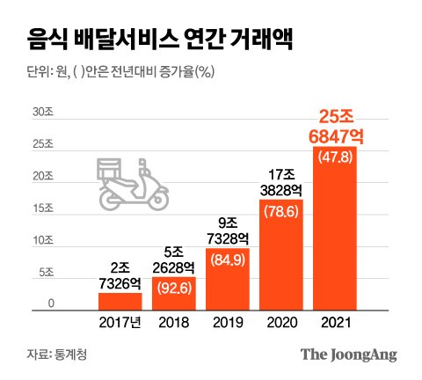
Why?

Slide 8
What We Make?
Team DBelivery

Slide 9
What We Make?
Statistics on change in order quantity according to delivery distance
Statistics on delivery amounts by month in all region.
Statistics on delivery volume by weather.
Statistics on delivery food cuisine by all region.
Statistics on delivery volume and items by family type . (single-person household, two-person household, etc.)
Statistics on delivery food items by age group.
Rank of delivery food categories across all periods and regions.
Statistics on the delivery volume by cuisine for each “도”as of July 2020.
Top 3 statistics for neighborhoods with the highest average delivery amounts.

Slide 10
Data Explanation
Team DBelivery

Slide 11

Data Explanation
Use Modified Delivery Data
From KT Big Data Platform
<Real JSON Data Example>
{ "Date": "2020-11-06",
"OrderWeek": "Wednesday",
"AREA": {
"Province": NaN,
"City": " 울산광역시 ",
"Neighborhood": “신정동 ",
"District": " 남구 " },
"Cuisine": "한식",
"Age": 29,
"Dist": 1500,
"Weather": "SUN",
"FType": "2세대",
"Price": 84500}
Date | ORDER_WEEK | AREA |  |  |  | Cuisine
20XX-XX-XX | Wednesday | P | C | D | N | 한식
 |  | N | 울 | 남 | 신
Age | Distance of Delivery(m) | Weather |  |  |  | Family Type
22 | 1500 | SUN |  |  |  | 2세대
<JSON Data Example>

Slide 12
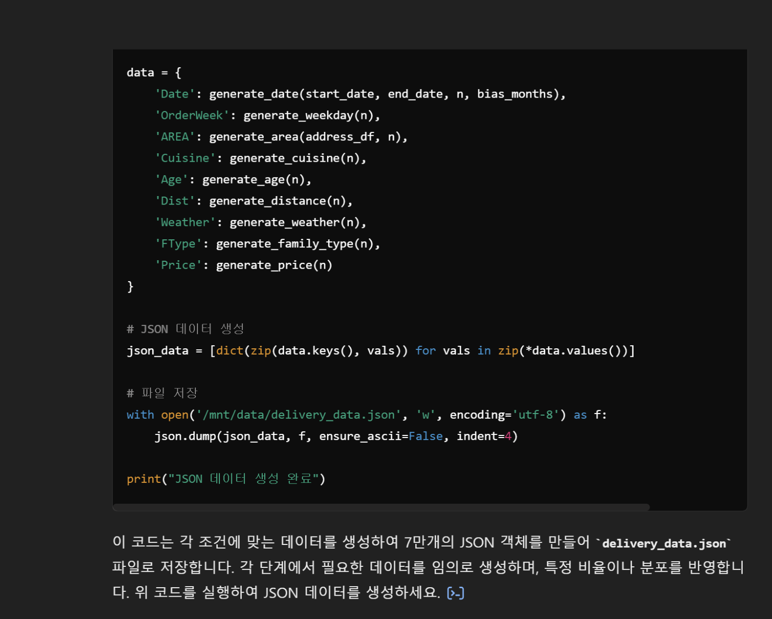
What We Do?
Data Preprocessing
Use ChatGPT & Python
To make Data Integrated

Slide 13
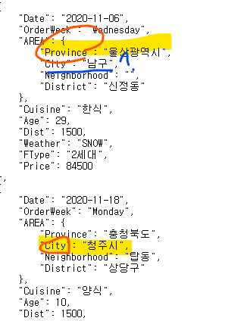
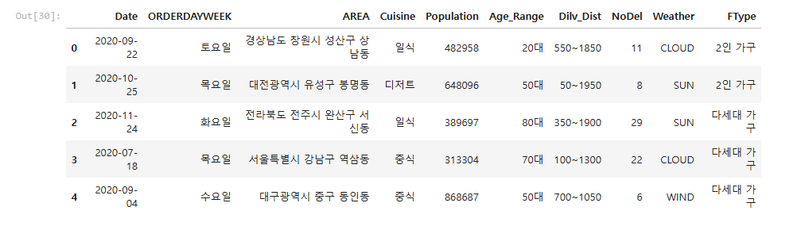
What We Do?
Data Preprocessing
An error occurs when the address is simply divided based on spaces.
“Provinces and cities are treated as Provinces”
Before Modification

Slide 14
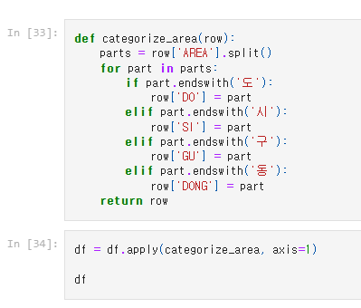
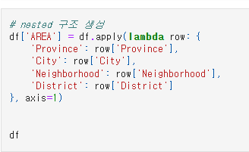
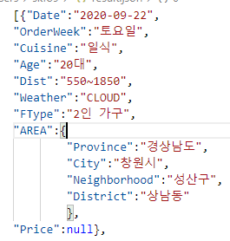
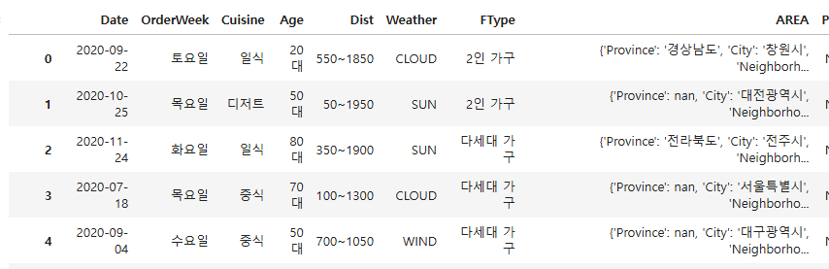
What We Do?
Data Preprocessing
After Modification

Slide 15


What We Do?
Data Visualization
Chart.js
Chart.js is an open-source JavaScript library that uses HTML5 canvas to generate various types of charts. This library was used to visualize several statistical datasets.
HTML5 Canvas
Chart.js uses the HTML5 <canvas> element to render graphics. <canvas> is an HTML element that can draw graphics pixel by pixel, which is very useful for creating charts or other graphics with JavaScript.

Slide 16
Queries / Results / Optimizations
Team DBelivery

Slide 17
Queries 1, 2, 3
by Min Kim
Team DBelivery

Slide 18
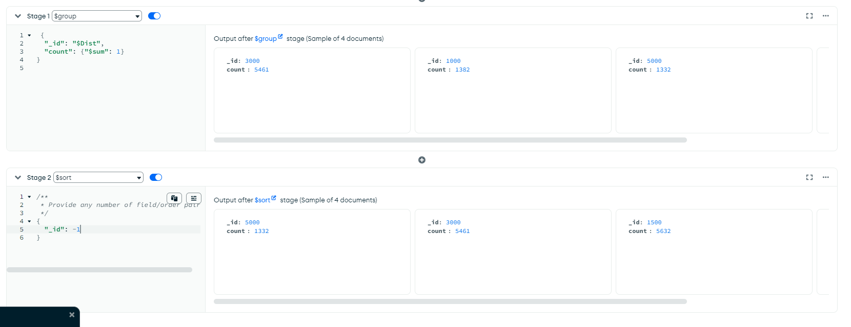
Query
1.Statistics on change in order quantity according to delivery distance
# 1. Statistics on delivery volume by distance in residential areas
distance_stats = collection.aggregate([
{"$group":
{"_id": "$Dist",
"count": {"$sum": 1}
}
},
{"$sort": {"_id": 1}}
])

Slide 19
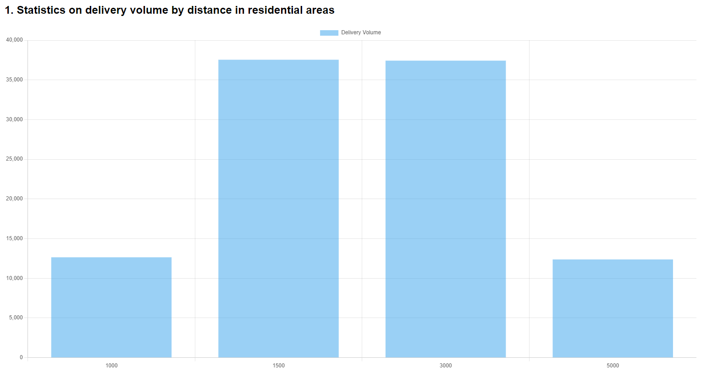
Result
1.Statistics on change in order quantity according to delivery distance

Slide 20
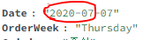
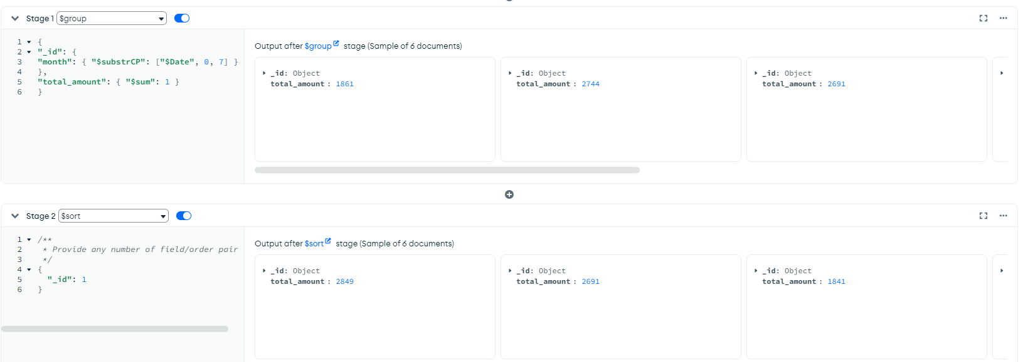
Query
2. Statistics on delivery amounts by month in all region.
$substrCP : The Query that return the part of String starting with <code point index>
Ref :
$substrCP: [ <string expression>, <code point index>, <code point count>
# 2. Statistics on delivery amounts by date (monthly, weekly) in residential areas
date_stats = collection.aggregate([
{"$group":
{"_id": {"month": {"$substrCP": ["$Date", 0, 7]}},
"total_amount": {"$sum": 1}}
},
{"$sort": {"_id": 1}}
])

Slide 21
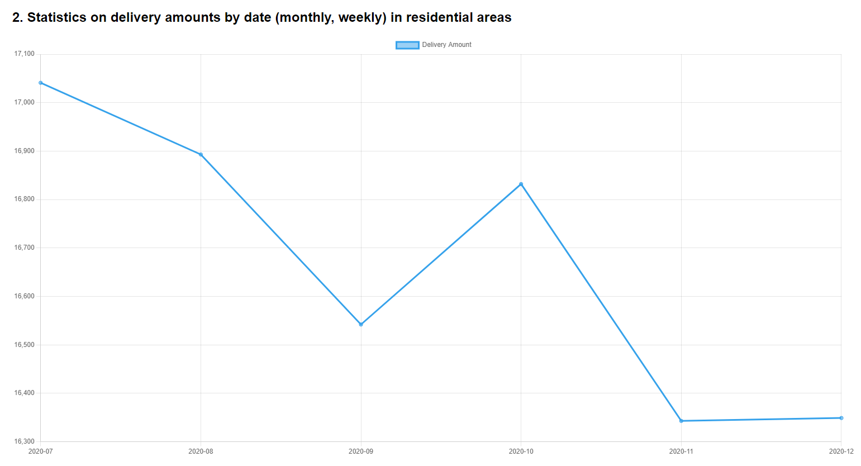
Result
2. Statistics on delivery amounts by month in all region.

Slide 22
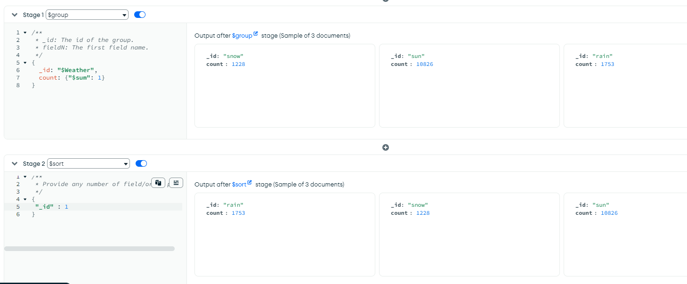
Query
3. Statistics on delivery volume by weather
# 3. Statistics on delivery volume by weather in residential areas
weather_stats = collection.aggregate([
{"$group":
{"_id": "$Weather",
"count": {"$sum": 1}}
},
{"$sort": {"_id": 1}}
])

Slide 23
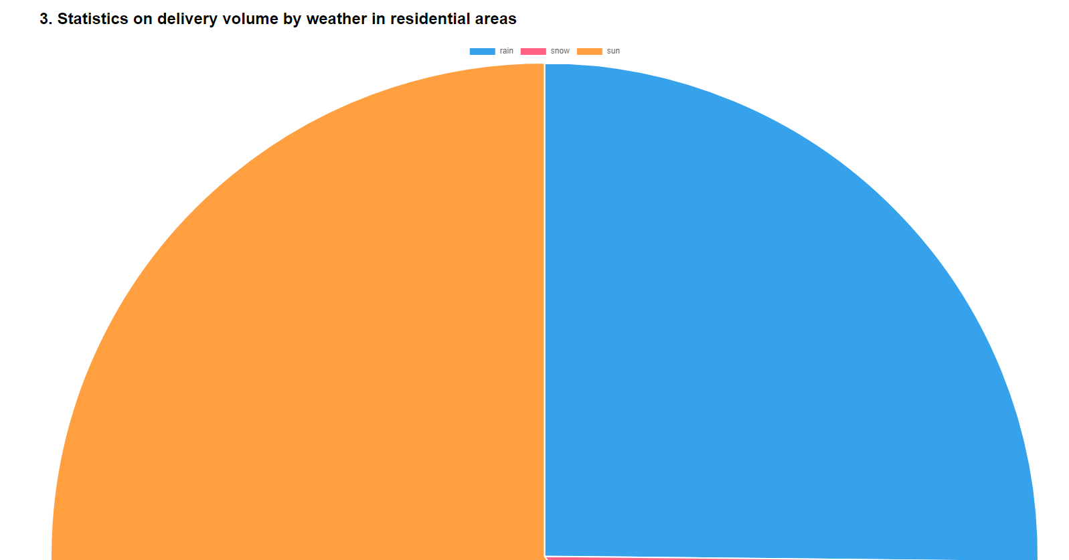
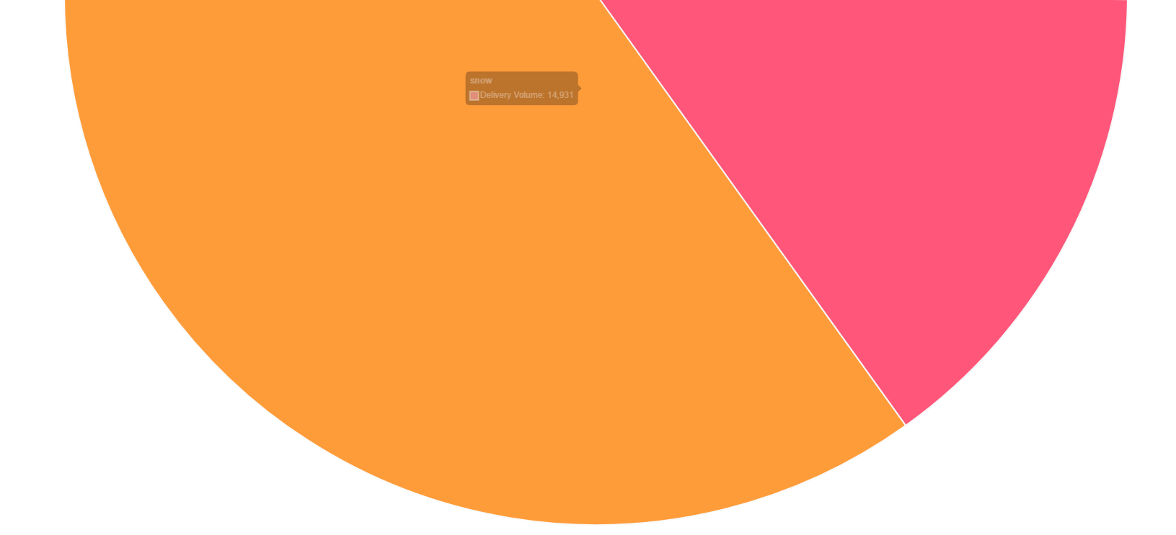
Result
3. Statistics on delivery volume by weather

Slide 24
Queries 4,5,6
by Mina Dong
Team DBelivery

Slide 25
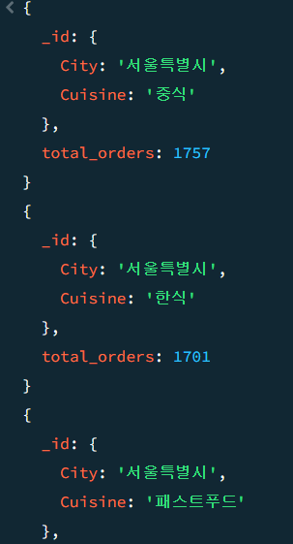
Query
4. Statistics on delivery food cuisine by all region
# 4.주거 지역별 배달 음식 품목 통계
delivery_city_stats = collection.aggregate([
{"$match": {
"AREA.City": {
"$ne": "null",
"$ne": ""
}
}},
{"$group": {
"_id": {
"City": "$AREA.City",
"Cuisine": "$Cuisine"
},
"total_orders": {"$sum": 1}
}},
{"$sort": {"total_orders": -1}},
{"$limit":30}
])

Slide 26
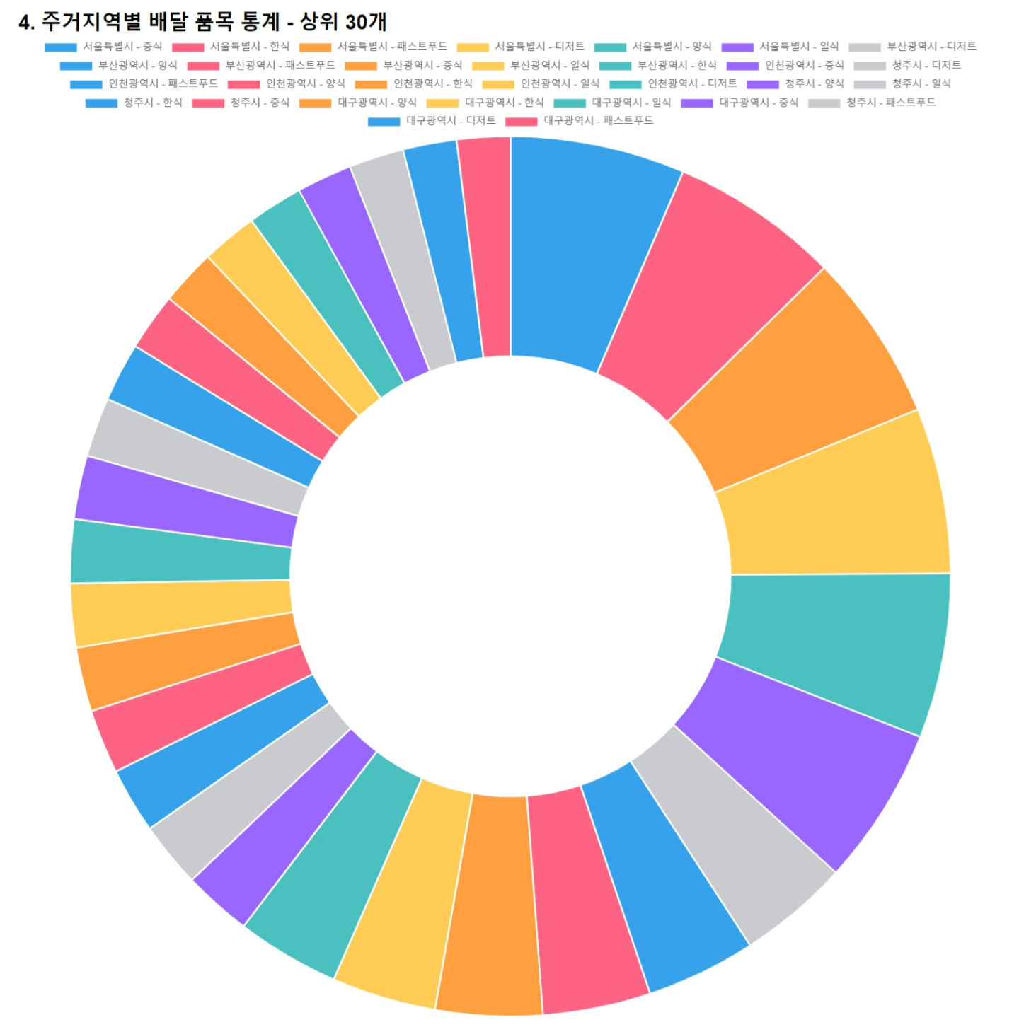
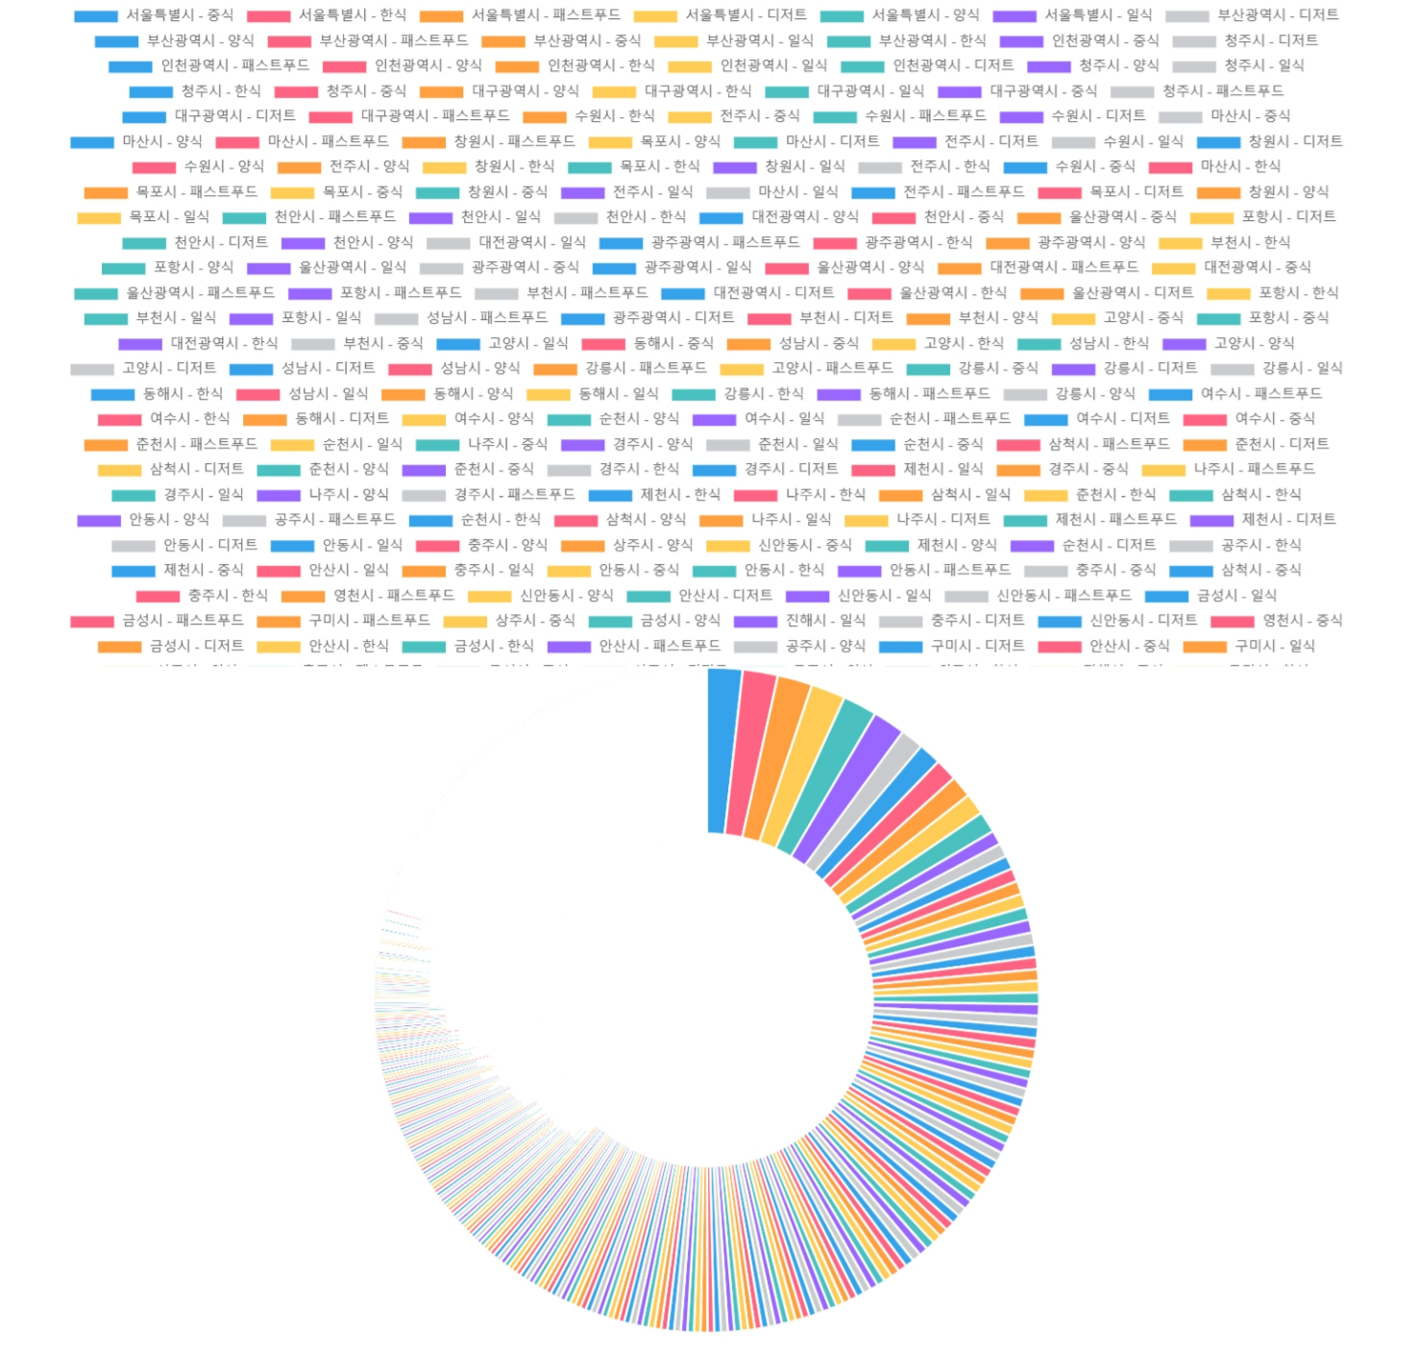

Result
4. Statistics on delivery food cuisine by all region, limited to top 30 items
limit 안하고
전체로 했을 경우
결과가 너무많음
→
limit : 30

Slide 27
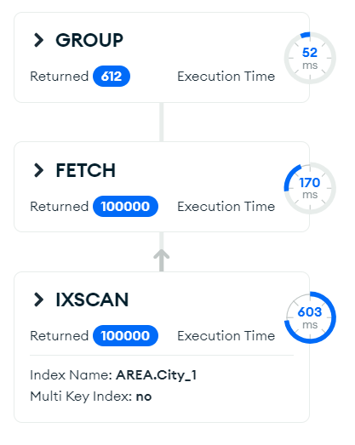
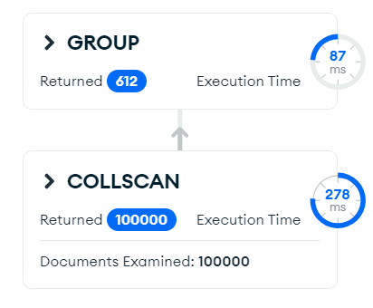
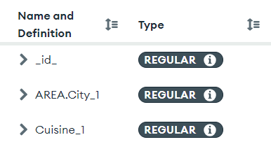
Optimization
4. Statistics on delivery food cuisine by all region
Increase 460ms
365ms
825ms

Slide 28
Query
5. Statistics on delivery volume and items by family type
# 5. 가구 유형별 배달량 및 금액 통계
Ftypes_cuisine_stats = collection.aggregate([
{
"$group": {
"_id": {
"Cuisine": "$Cuisine",
"FType": "$FType"
},
"total_orders": { "$sum": 1 },
"average_price": { "$avg": "$Price" },
"min_price": { "$min": "$Price" },
"max_price": { "$max": "$Price" }
}
},
{
"$sort": { "total_orders": -1 }
},
{
"$group": {
"_id": "$_id.Cuisine",
"ftypes": {
"$push": {
"FType": "$_id.FType",
"average_price": "$average_price",
"min_price": "$min_price",
"max_price": "$max_price"
}
}
}
},
{
"$project": {
"_id": 1,
"top_3_ftypes": { "$slice": ["$ftypes", 3] } #상위 가구 3개까지
}
}
])

Slide 29
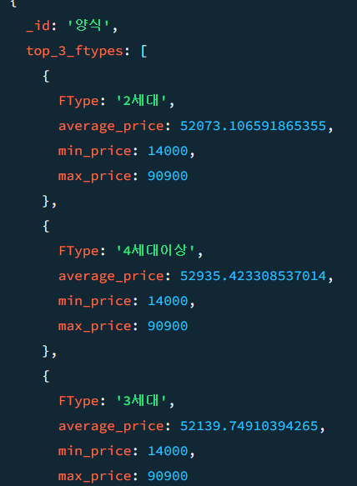
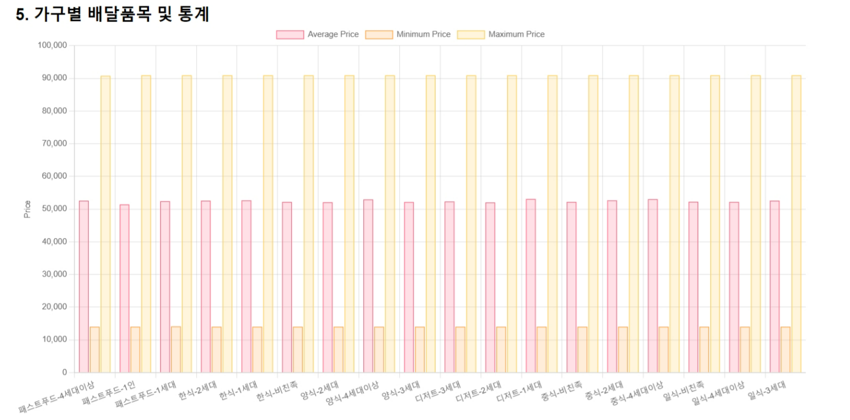
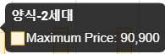
Result
5. Statistics on delivery volume and items by family type

Slide 30
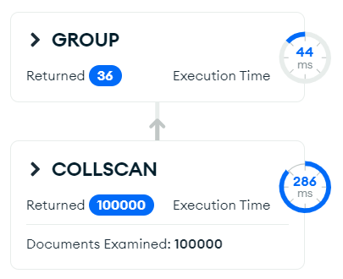
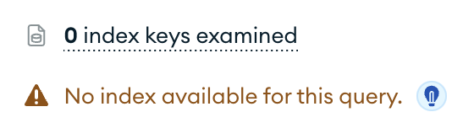
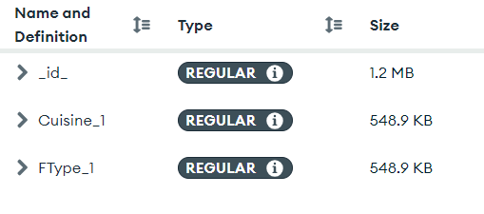
Optimization
5. Statistics on delivery volume and items by family type

Slide 31
Query
6. Statistics on delivery food items by age group
# 6. 연령대별 배달 음식 품목 통계
age_stats = collection.aggregate([
{
"$group": {
"_id": {
"age_group": {
"$switch": {
"branches": [
{"case": {"$lte": ["$Age", 10]}, "then": "0-10"},
{"case": {"$lte": ["$Age", 20]}, "then": "11-20"},
{"case": {"$lte": ["$Age", 30]}, "then": "21-30"},
{"case": {"$lte": ["$Age", 40]}, "then": "31-40"},
{"case": {"$lte": ["$Age", 50]}, "then": "41-50"},
],
"default": "etc"
}
},
"Cuisine": "$Cuisine"
},
"total_orders": {"$sum": 1}
}
},{ "$sort": {"_id.age_group": 1, "total_orders": -1}}
])

Slide 32
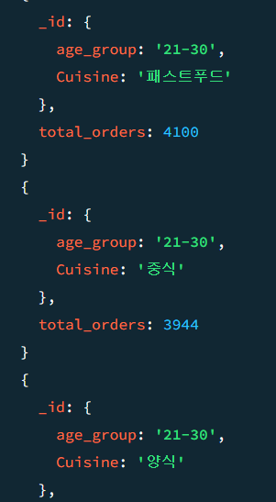
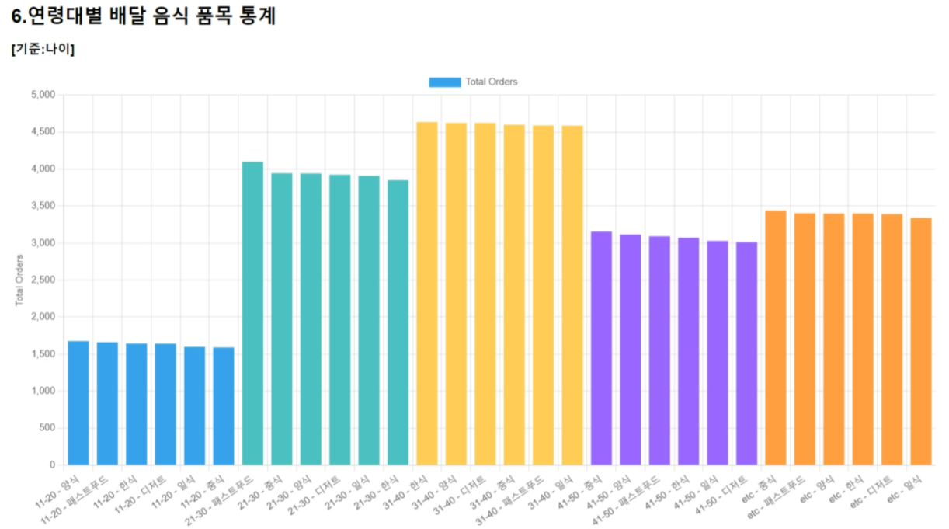
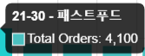
Result
6. Statistics on delivery food items by age group

Slide 33
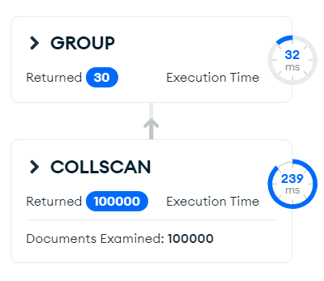
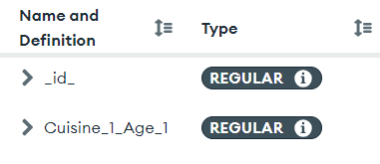
Optimization
6. Statistics on delivery food items by age group

Slide 34
Queries 7,8,9
by Jin Gyeong Lee
Team DBelivery

Slide 35
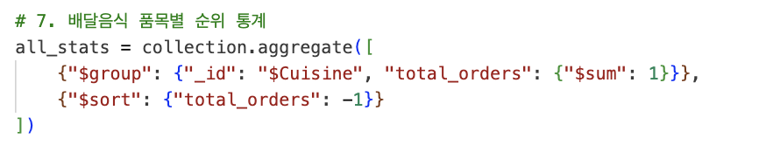
Query
7. Rank of delivery food categories across all periods and regions

Slide 36
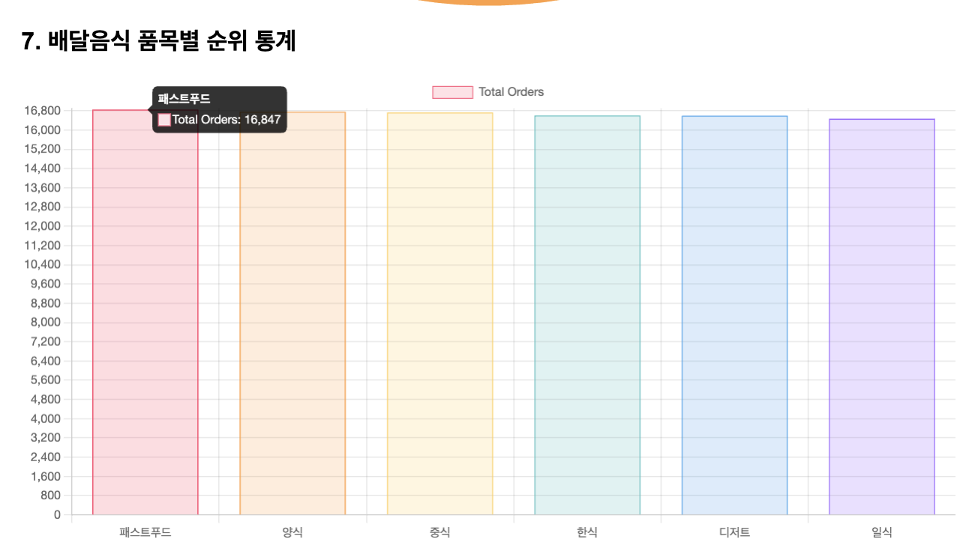
Result
7. Rank of delivery food categories across all periods and regions

Slide 37
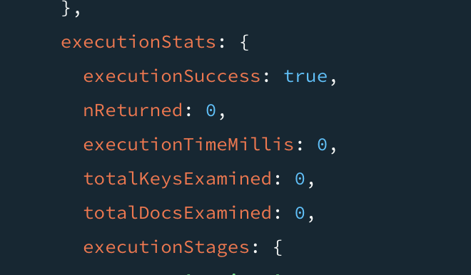
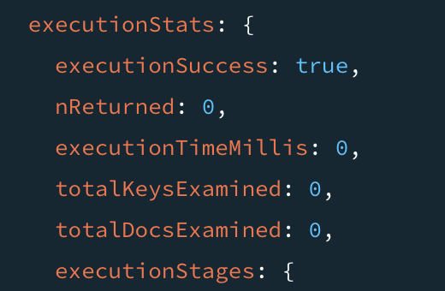

Optimization
7. Rank of delivery food categories across all periods and regions

Slide 38
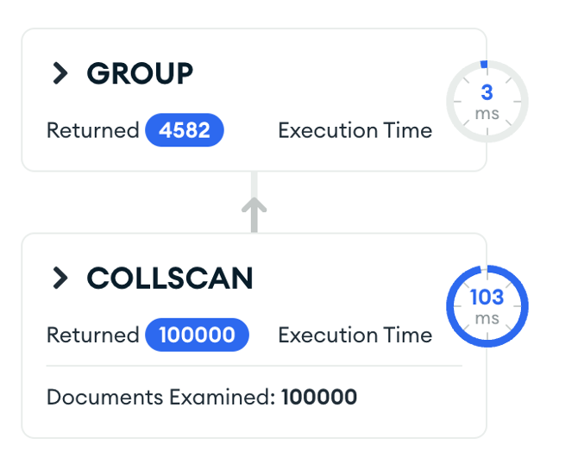
Optimization
7. Rank of delivery food categories across all periods and regions

Slide 39
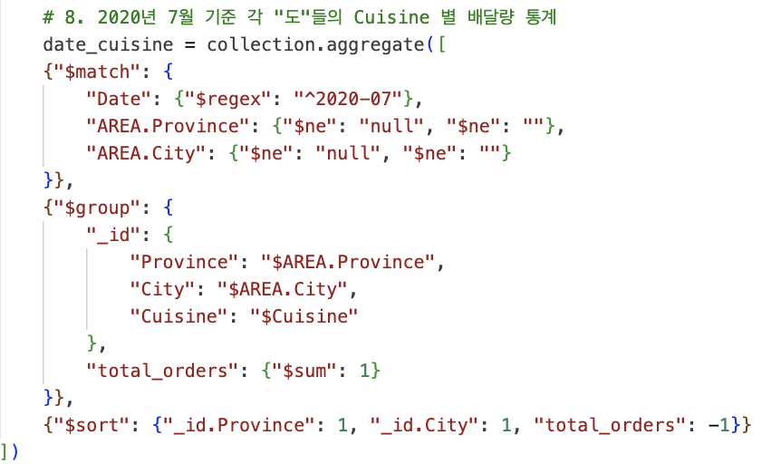
Query
8. Statistics on the delivery volume by cuisine for each “도”as of July 2020.

Slide 40
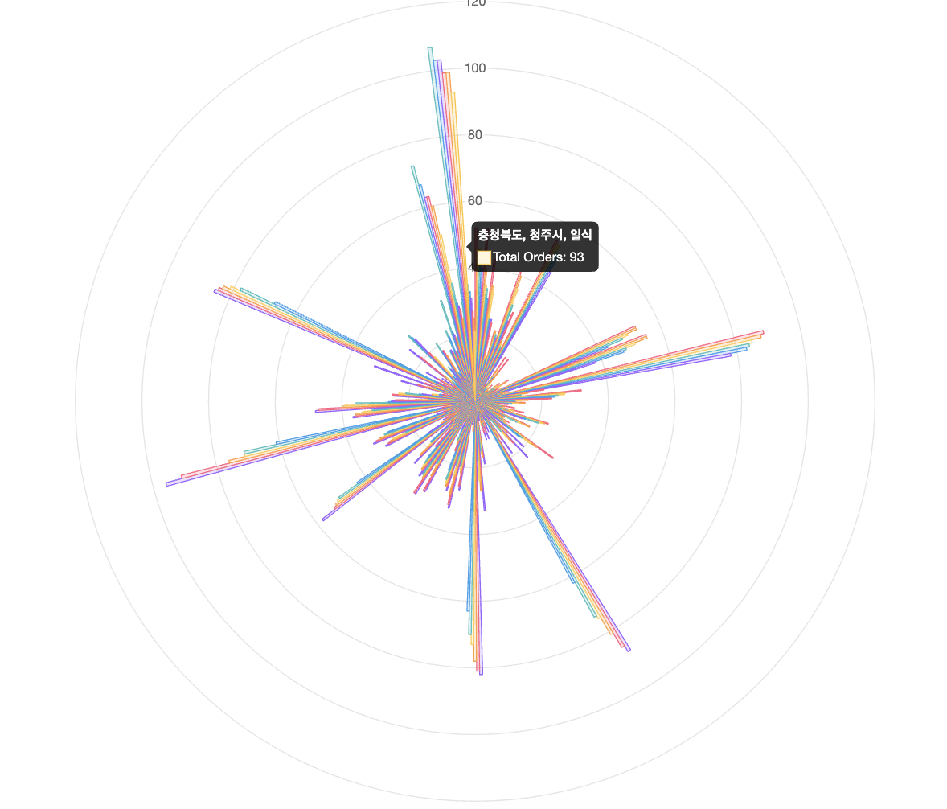
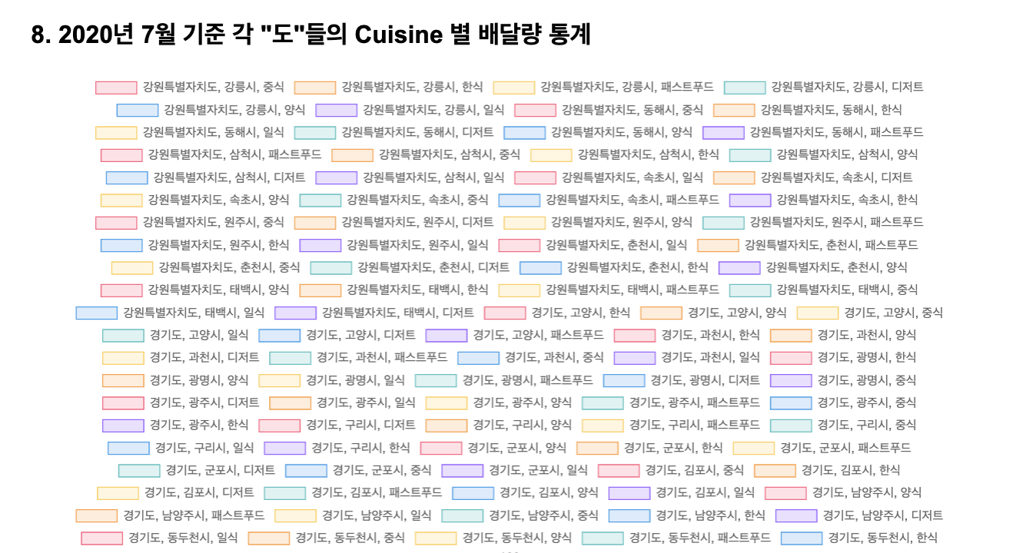
Result
8. Statistics on the delivery volume by cuisine for each “도”as of July 2020. (“시” 제외)

Slide 41
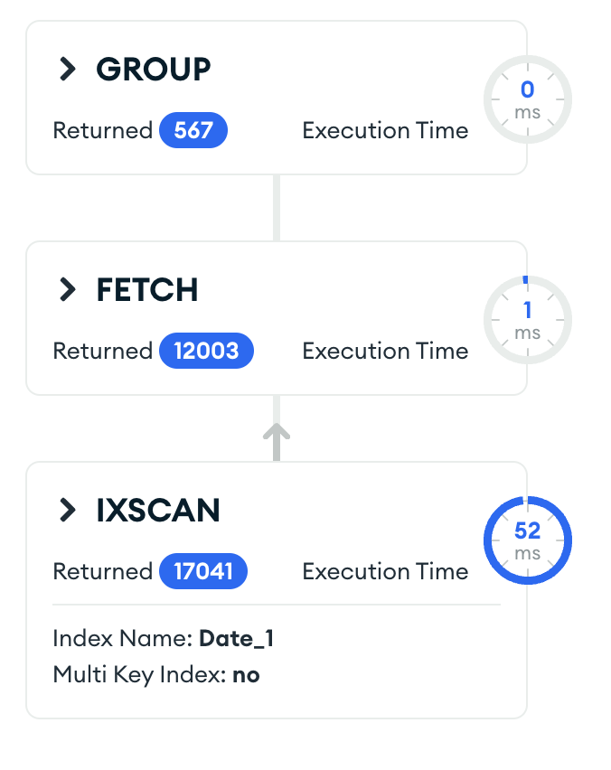
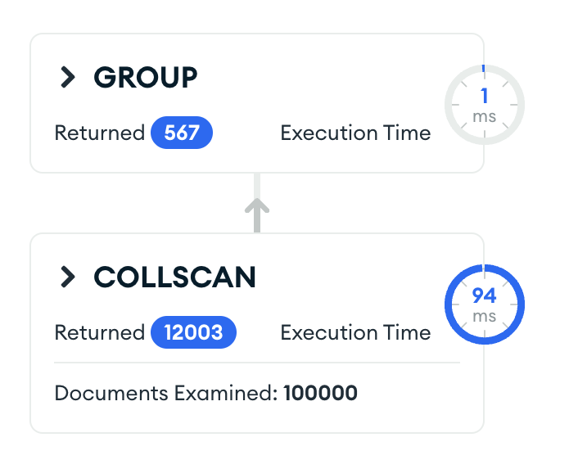
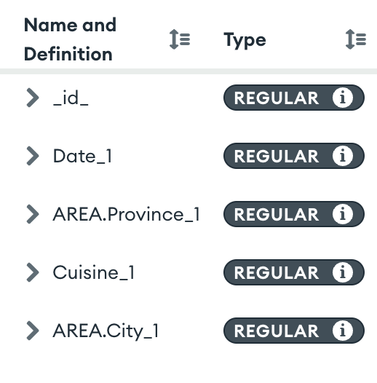
Optimization
8. Statistics on the delivery volume by cuisine for each “도”as of July 2020.
Decrease 41ms

Slide 42
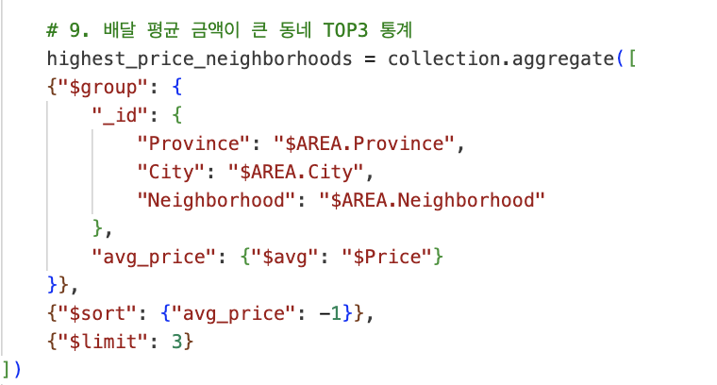
Query
9. Top 3 statistics for neighborhoods with the highest average delivery amounts.

Slide 43
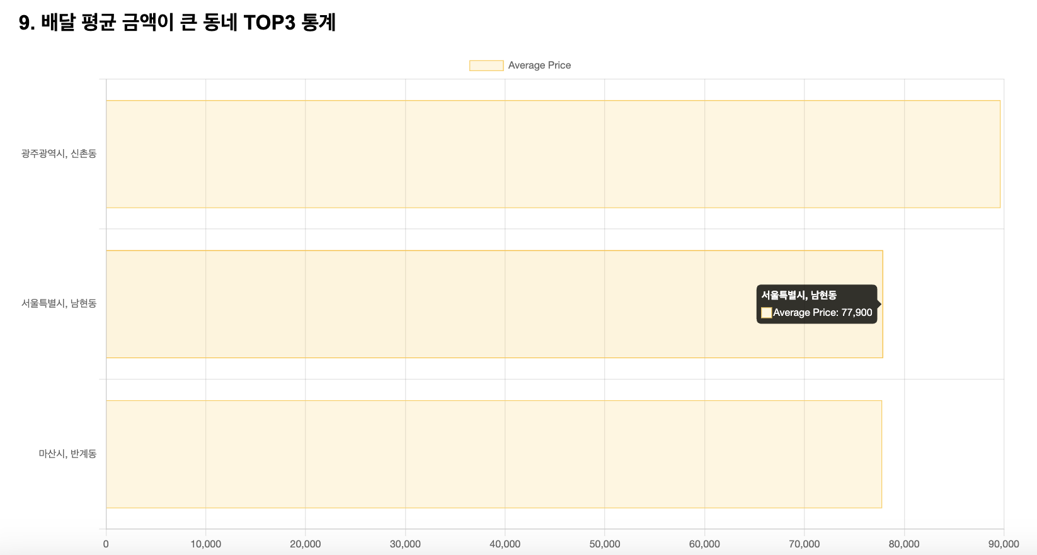
Result
9. Top 3 statistics for neighborhoods with the highest average delivery amounts.

Slide 44
Optimization
9. Top 3 statistics for neighborhoods with the highest average delivery amounts.

Slide 45
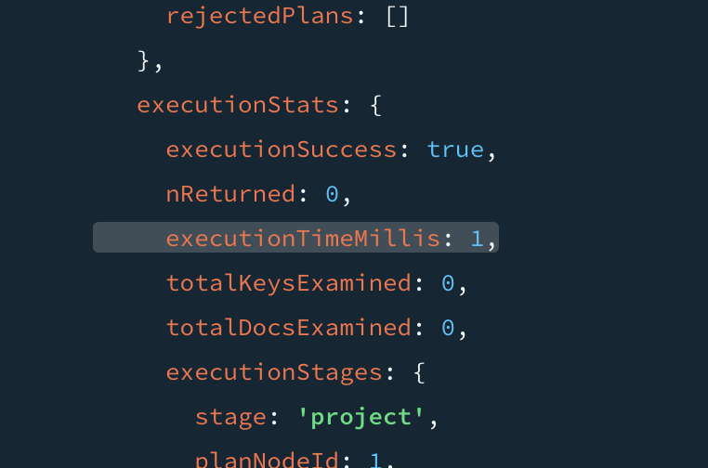
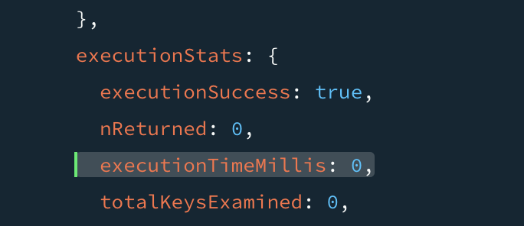
Optimization
9. Top 3 statistics for neighborhoods with the highest average delivery amounts.
Increase

Slide 46
Demo Video
Team DBelivery

Slide 47
Demo Video
Video Link

Slide 48
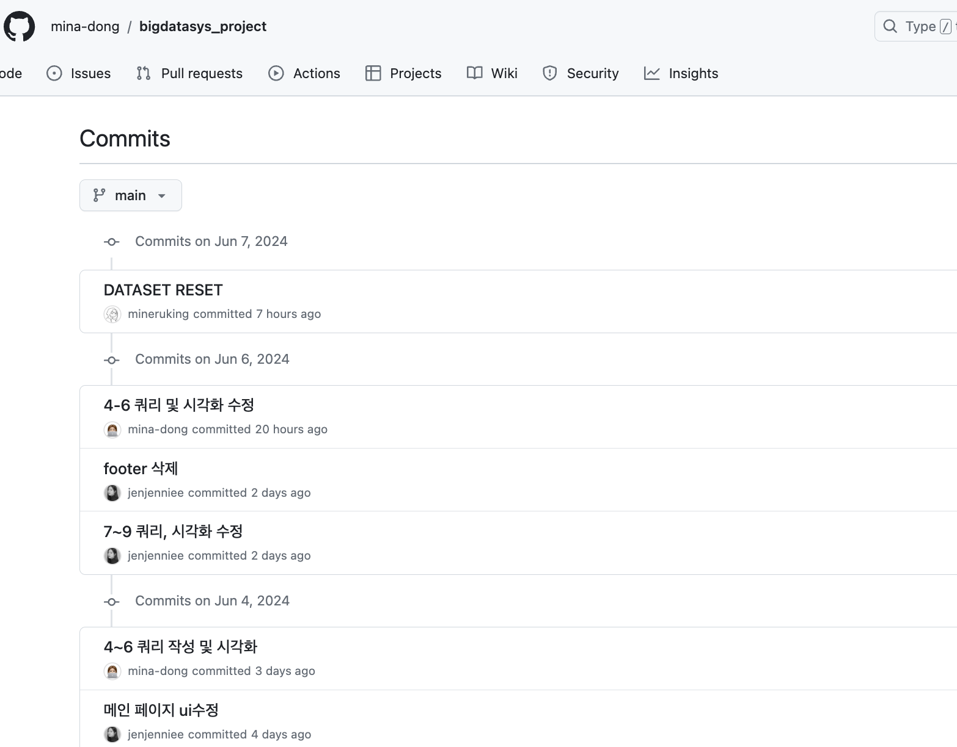
Source code
https://github.com/mina-dong/bigdatasys_project

Slide 49
Thank You!
Reference - Freepik : Delivery (Picture of Page 1)
- Freepik : Delivery (Picture of Page 4)
- KT Big Data Platform (Logo of Page 6)

